Slide 1



CFDE SHORT COURSE: Human Microbiome Data Discovery 2026
Fusobacterium nucleatum & interspecies metabolites exchange in oral biofilm
<Group Two> Presentation
Presenters: Sheetal Akula, Hua Zhang, Zhengzhong Zou, Jia Hui Isabelle Jang.
Sunday, 9/20/2026
Notes:
Please update this for your title slide

Slide 2
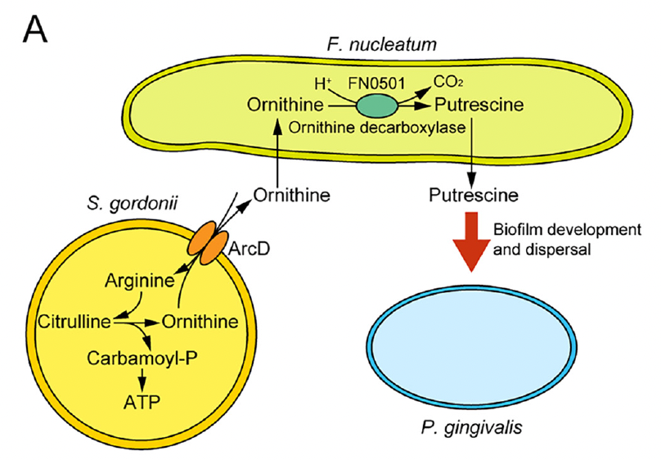
BACKGROUND/IMPORTANCE
An inflammatory environment related to periodontitis is associated with development of oral cancers.
Fusobacterium nucleatum is a common and important constituent of oral microbiome and polymicrobial oral biofilms.
Metabolic integration within oral polymicrobial communities are poorly understood.
Figure. Metabolic cross-feeding between oral bacteria can support community growth and pathogen colonization.
Notes:
Other notes:
•Oral biofilms are multispecies communities where metabolic “cross-feeding” between species can enable pathogen colonization; Fusobacterium nucleatum (Fn) is proposed as a metabolic bridge linking early colonizers to later pathogens.

Slide 3

AIM/GOAL
To compare the extracellular metabolite profiles of F. nucleatum alone compared with F. nucleatum cocultured with Streptococcus gordonii and/or Veillonella parvula.

Slide 4

CFDE DATA RESOURCES
CFDE Resources Used:
Metabolomics workbench
Accessed through journal website which referenced metabolomics workbench study ID (https://journals.asm.org/doi/10.1128/msystems.00170-22#dataS1)
Search Process:
CFDE Cloud
iPOP HMP website
Metabolomics workbench

Slide 5
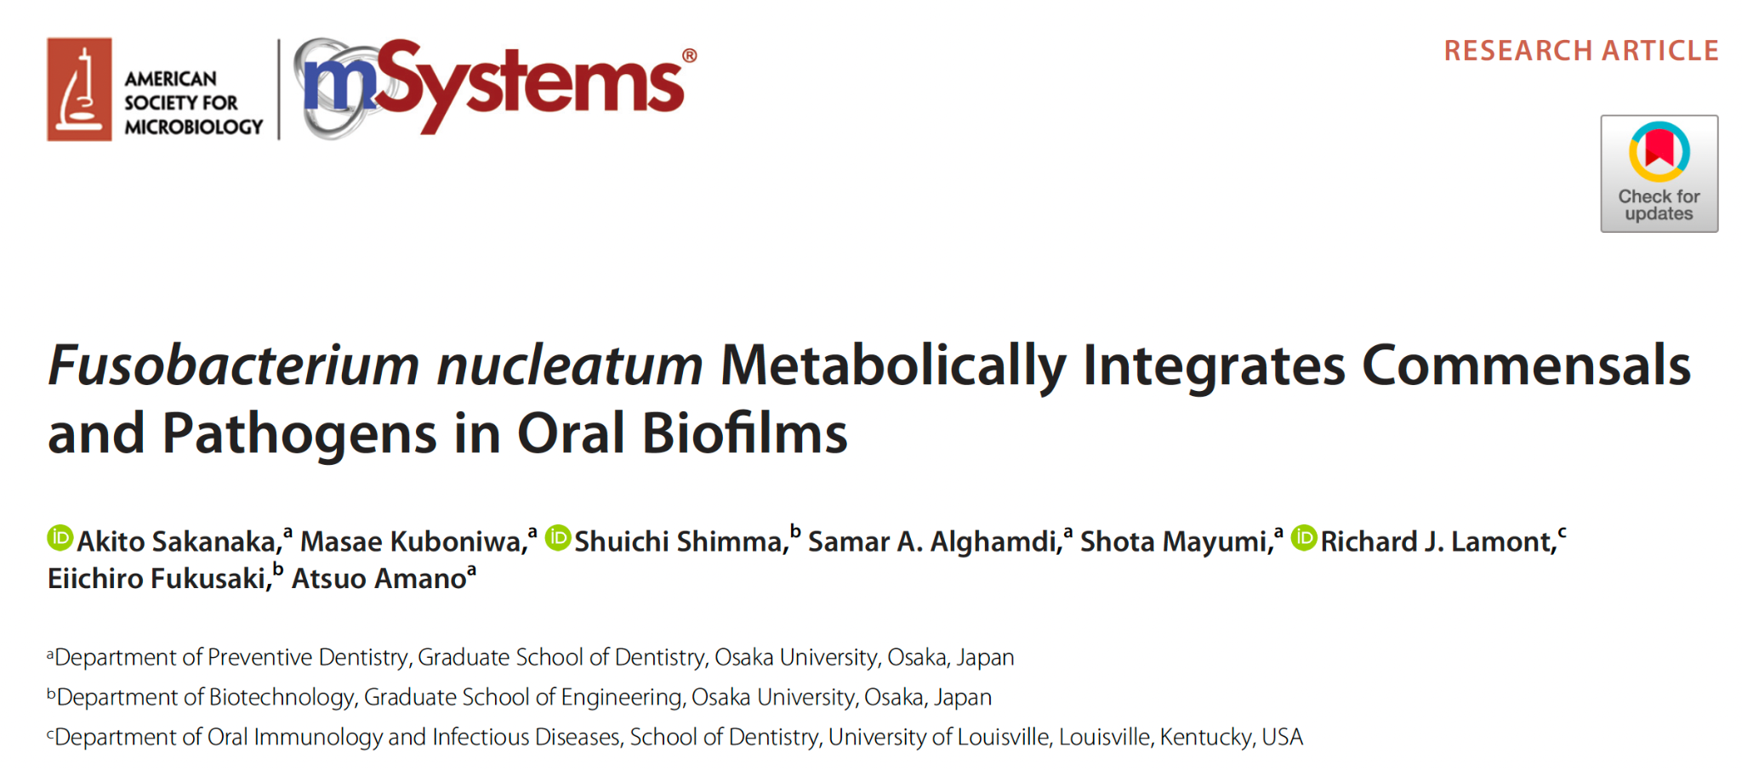
Notes:
This is the paper we are basing our analysis on.

Slide 6
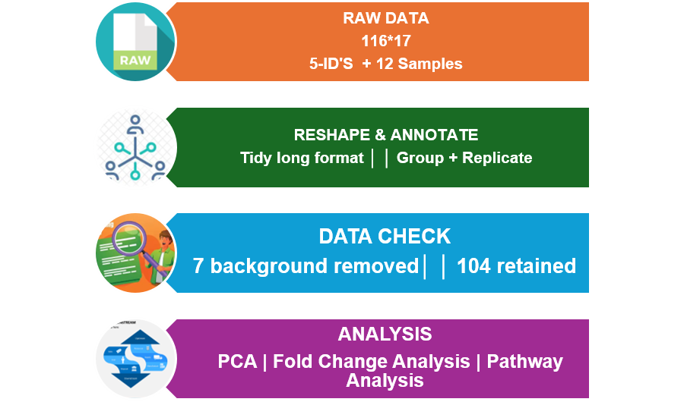
APPROACH
Notes:
Parsed the single-sheet workbook
(116 rows × 17 columns): 5 identifier columns (Metabolite,KEGG_ID, HMDB_ID, m/z, RT) plus 12 sample columns (4 conditions × 3 replicates). Reshaped to tidy long format, deriving Group (culture condition) and Replicate from each sample name by regex.
• Removed 7 metabolites flagged in the source spreadsheet (via cell shading) as sterile-medium
background rather than bacterial output, leaving 104 of 111 metabolites for analysis.
• Used a half-minimum pseudocount for all log2 transforms (PCA, heatmap, fold-change) —
appropriate here because non-detects in this dataset are true zeros, not left-censored values

Slide 7
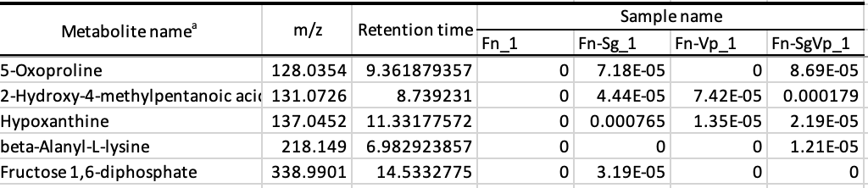
EXPECTATIONS
The data met our expectations.
Well organized
Labels are clear:
  Sample name
  Metabolite name
  m/z ratio
  Retention time
  KEGG and HMDB identifiers were available for metabolite annotation
Limitation: Only the curated metabolite table was publicly available; raw spectral files and extended QC metrics were not provided

Slide 8
LESSONS
What was learned from this process?
Understand the data before transformation
True zeros ≠ censored/BLOQ values
Preprocessing affects results
Zero handling impacts log₂ transformation and fold-change
Always visually validate outputs
Coding errors can silently produce incorrect results, such as an all-NA heatmap
More about Principal component analysis

Slide 9
ANALYSIS
Analysis | Why
Exploratory Analysis | Compare metabolite detection across cultures
Principal Component Analysis | Explore overall metabolome patterns and clustering
Log2-Fold Change | Qualify changes in metabolites differing across co-cultures
Pathway Analysis | Compare metabolites specific to certain pathways
Notes:
What types of analyses were you able to perform? Why did you choose these analyses? What analyses were you expecting to do?
The Kruskal-Wallis test is a non-parametric statistical test used to determine if there are statistically significant differences between three or more independent groups on a continuous or ordinal dependent variable.

Slide 10
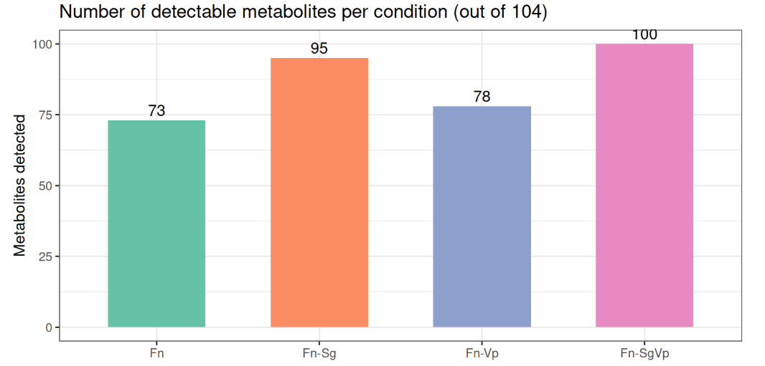
RESULTS
Figure. Number of metabolites detected in each culture.
Total 104 unique metabolites detected in the study.
Notes:
These were the results of our analysis.
This figure shows the number of metabolites detected in each monoculture or co-culture, with a total of 104 unique metabolites identified in our study.

Slide 11
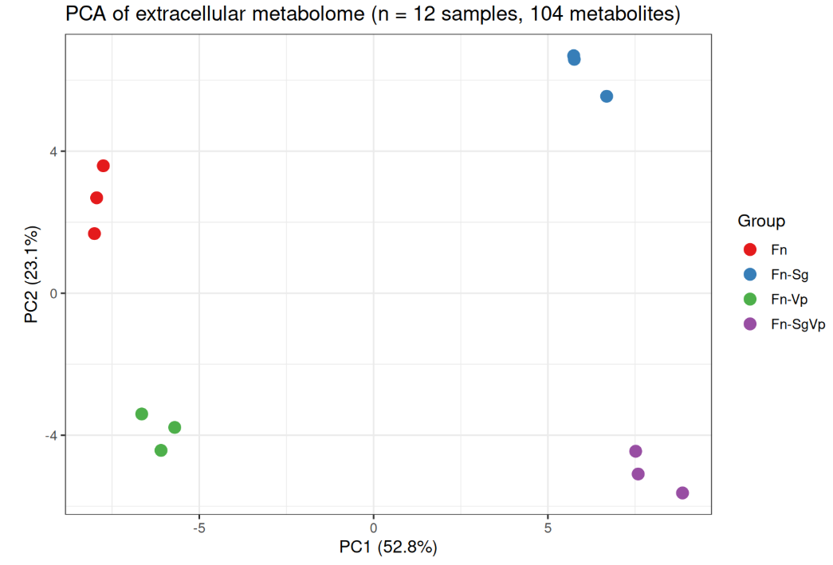
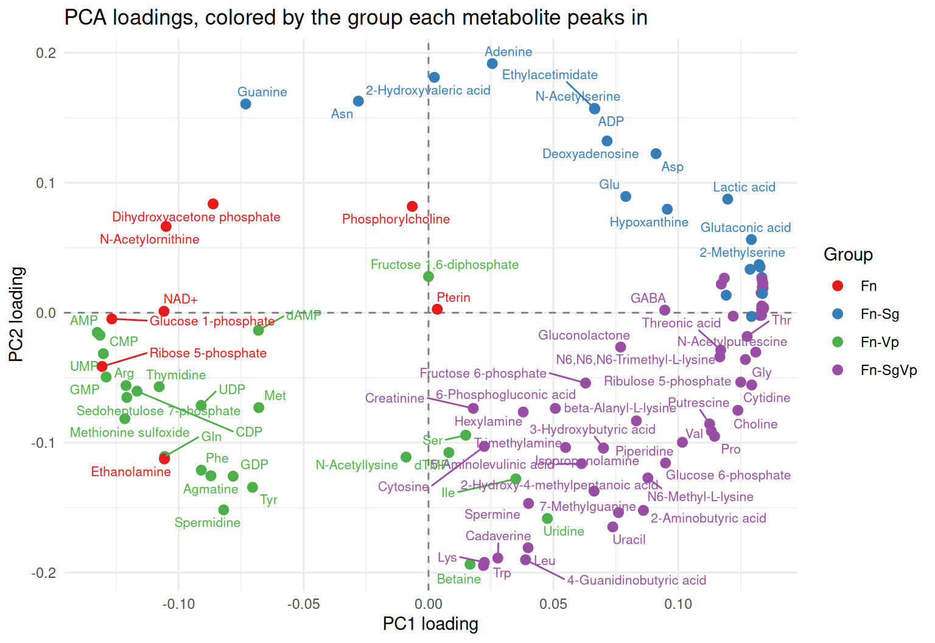
RESULTS
Figure. PCA plot of samples from the different cultures/co-cultures showing 4 distinct clusters
Figure. Plot of PC2 vs PC1 showing metabolites associated with different quadrants
Notes:
Our PCA plot showed by the plot on the left illustrates 4 distinct groups - showing Fn monoculture, Fn-SG co-culture, Fn-VP co-culture and Fn-SGVP co-culture.
When plotting PC2 vs PC1 loadings to look for metabolites accounting for the key principal components, the figure on the right showed the metabolites associated with the different culture groups in each quadrant of our PCA plot.

Slide 12
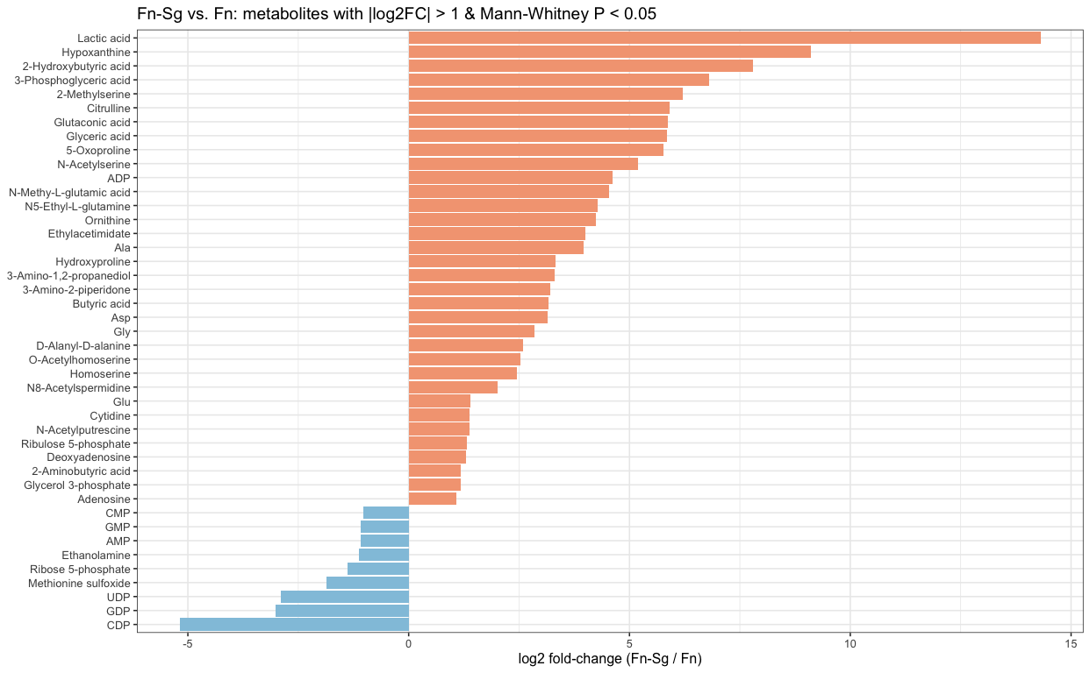
RESULTS
Figure. Log2fold change plot of metabolites change showing significant changes in F. nucleatum with S. gondii vs F. nucleatum alone
Notes:
We did a log2fold change analysis to look for metabolites showing significant changes in F nucleatum with S gondii vs F nucleatum alone.
The metabolites that were upregulated are in orange and those that are downregulated are in blue.
Results are similar to paper, but we did not filter for fewer metabolites.

Slide 13
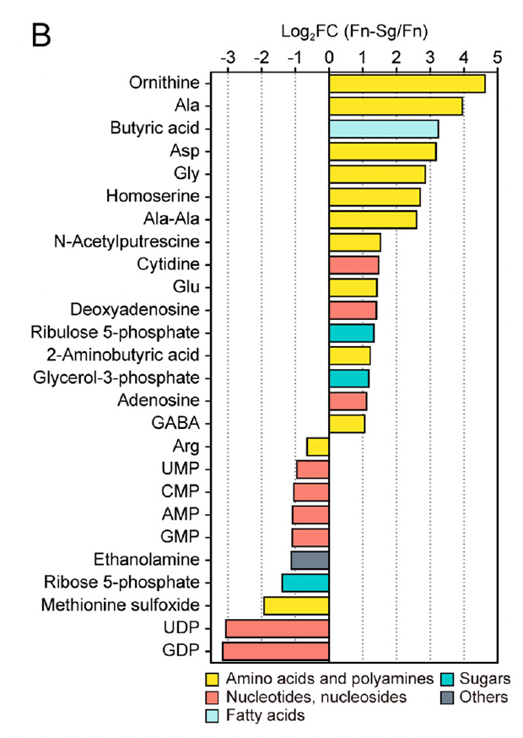
RESULTS
Figure. Log2fold change plot of metabolites change showing significant changes in F. nucleatum with S. gondii vs F. nucleatum alone
Notes:
Results are similar to paper, but we did not filter for fewer metabolites.

Slide 14
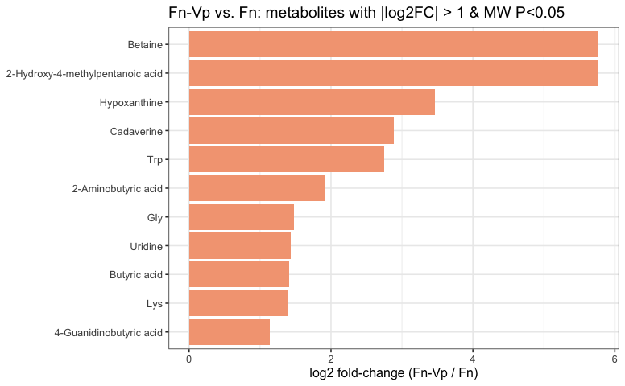
RESULTS
Figure. Log2fold change plot of metabolites change showing significant changes in F. nucleatum with V. parvula vs F. nucleatum alone
Notes:
This figure shows the log2fold change analysis to look for metabolites showing significant changes in F nucleatum with V parvula vs F nucleatum alone.
The metabolites that were upregulated are in orange.

Slide 15
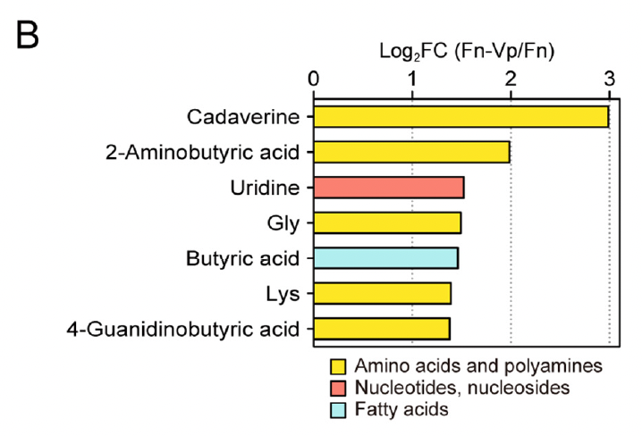
RESULTS
Figure. Log2fold change plot of metabolites change showing significant changes in F. nucleatum with V. parvula vs F. nucleatum alone
Notes:
Results are similar to paper, but we did not filter for fewer metabolites.

Slide 16
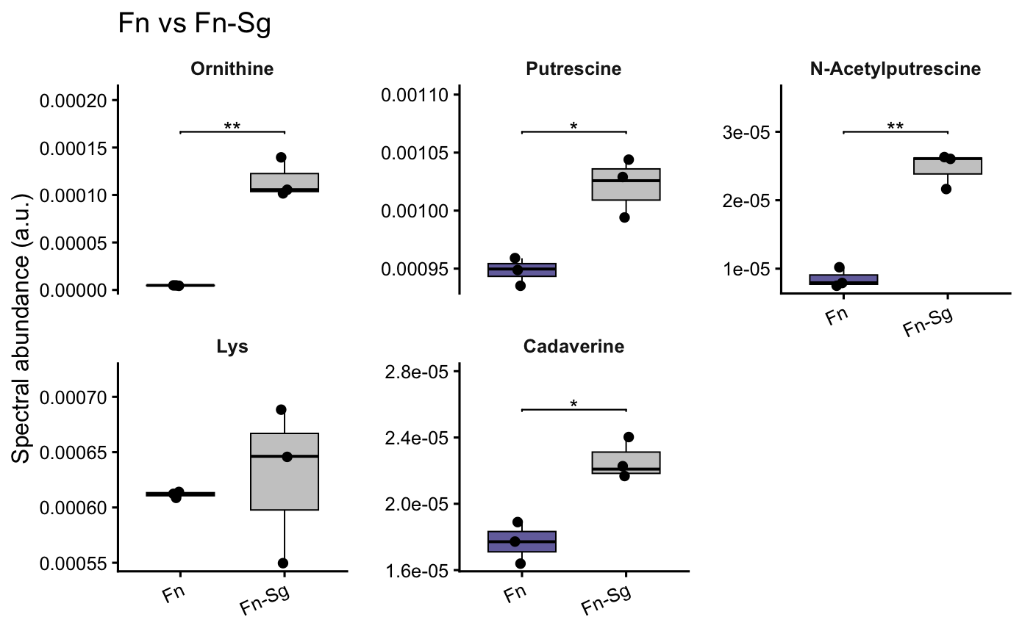
*** denotes statistical significance.
RESULTS
Figure.Levels of metabolites spent in Fn-Sg coculture and Fn monoculture showing that ornithine, putrescine and downstread N-acetylputrescine is elevated when SG is present (as expected)
Notes:
In the paper they were testing hypotheses of some metabolites are related to certain pathway changes in co-cultures.
The authors tested the hypothesis that If *S. gordonii* releases ornithine that Fn converts to putrescine, **Ornithine and Putrescine (and downstream N-Acetylputrescine) should be elevated specifically when Sg is present, not when VP is present. This is seen in this figure where ornithine, putrescine and n-acetyleputrescine are significantly higher in Fn-SG co-cultures compared to Fn.
=======================
This is the direct test of the hypothesis. If *S. gordonii* releases ornithine that Fn converts to putrescine, **Ornithine and Putrescine (and downstream N-Acetylputrescine) should be elevated specifically when Sg is present** (Fn-Sg and Fn-SgVp), not when only Vp is present. Symmetrically, **Lysine and Cadaverine should be elevated specifically when Vp is present** (Fn-Vp and Fn-SgVp).

Slide 17
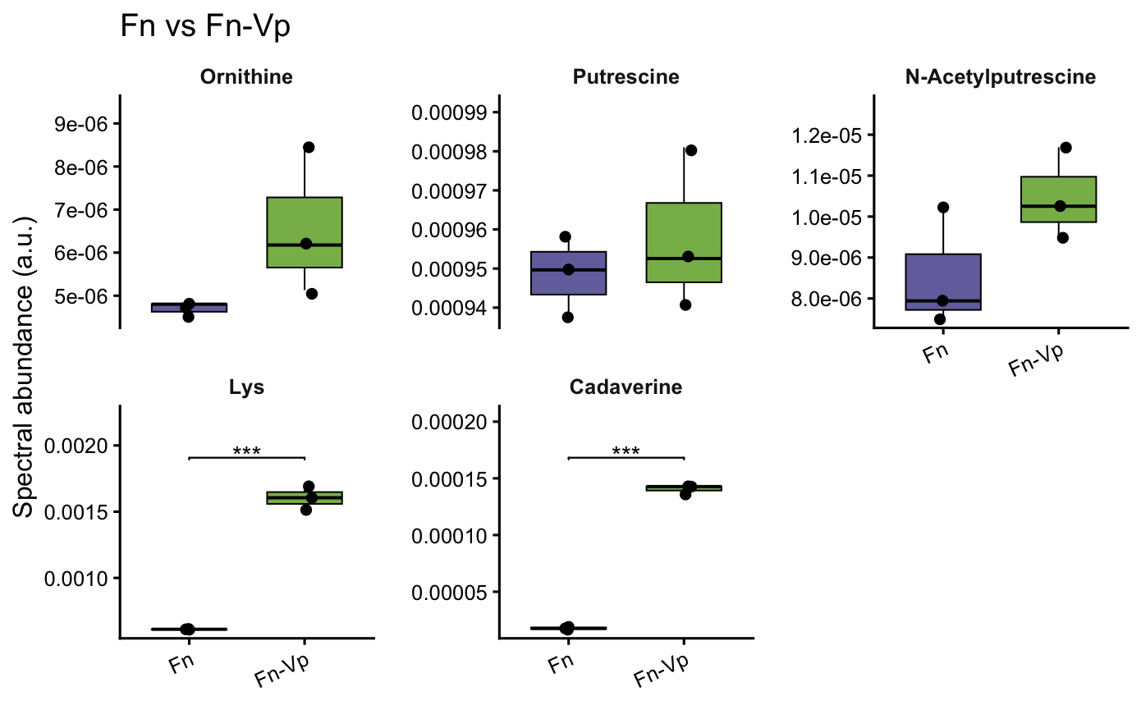
*** denotes statistical significance.
RESULTS
Figure.Levels of metabolites spent in Fn-Vp coculture and Fn monoculture showing that lysine and cadaverine is elevated; and ornithine, putrescine, N-acetylputresciene is not elevated when Vp is present (as expected).
Notes:
When comparing metabolites in the Fn-Vp co-culture vs Fn alone, the authors expected Lysine and Cadaverine to be elevated specifically when Vp is present, seen in our figure.
They also expected Ornithine and Putrescine (and downstream N-Acetylputrescine) to not be different from Fn alone, which is seen in our figure.
*** denotes statistical significance.

Slide 18
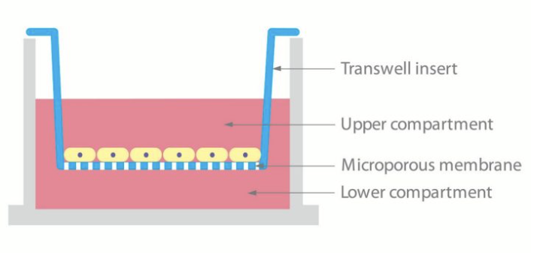
LIMITATIONS
Small Sample Size
n = 3 replicates/condition
Require non-parametric testing
Study used Transwell Model
Measures only diffusible, contact-independent metabolites
Does not capture cell-contact interactions or full multispecies biofilm dynamics
Focus on extracellular metabolites due to limited time
https://share.google/10SLXodl7VrpbQiVt
Notes:
Limitations of our analysis included:
Small sample size of 3 replicates per culture, requiring non-parametric statistical handling of results.
Our study also used a transwell model, which measures only diffusible, contact-independent metabolites; which does not capture cell-contact interactions or full multispecicies biofilm dynamics.
Our analysis only focuses on extracellular metabolites due to limited time. We did not explore the intracellular metabolite dataset for this same cohort.

Slide 19
FUTURE DIRECTION
If you had more time, which additional analyses would you perform?
Download data from other studies to reproduce
What additional questions did the analysis support?
Study of Fusobacterium Nucleatum with other co-cultures in vivo model (e.g. animal model)
Notes:
If we had more time we would like to download more data from other studies to reproduce the data.
Our analysis supports the study of fusobacterium with co-cultures in in-vivo models.

Slide 20

Generated by google gemini
Notes:
With that we thank you for your kind attention; and are happy to take any questions.

